Slide 1
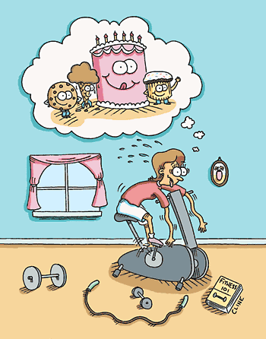
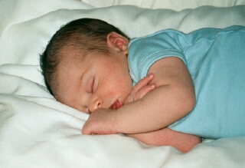
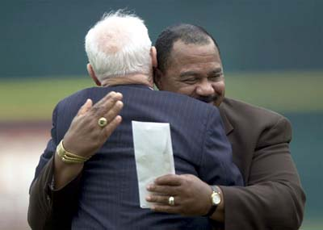
Healthy Body, Healthy Mind

Slide 2
Wonder Drug!
Feel good
Enhances self-esteem
Induces calm
Improves thinking
Makes you more attractive
No negative side effects
It’s legal
It’s free

Slide 3

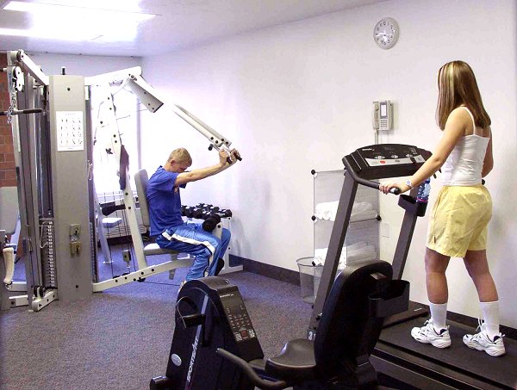
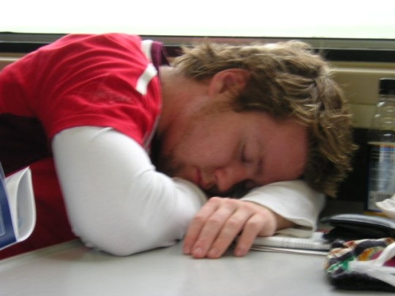
Overview
Exercise
Sleep
Touch

Slide 4
Mind AND Body
Cartesian dualism

Slide 5
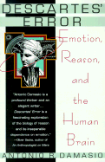
“This is Descartes’ error: the abyssal separation between body and mind, between the sizable, dimensioned, mechanically operated, infinitely divisible body stuff, on the one hand, and the unsizable, undimensioned, un-pushpullable, nondivisible mind stuff; the suggestion that reasoning, and moral judgment, and the suffering that comes from physical pain or emotional upheaval might exist separately from the body.” Antonio Damasio

Slide 6
Mind AND Body
Cartesian dualism
The limits of ‘pure psychology’
The limits of ‘pure medicine’
Bridge building
  east-west
  psychology-medicine

Slide 7
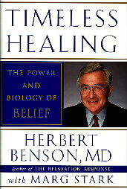
“I view health and well-being as a three-legged stool: one leg is pharmaceuticals, a second leg is surgery and procedures. We have at our disposal awesome medications and surgeries. Many of us would not be alive today without them. Yet we need a third leg: self-care. This includes the relaxation response, spirituality, nutrition, exercise, and stress management. Unfortunately, we’re trying to use the first two legs—the surgery or the pharmaceutical—to deal with stress-related issues where they don’t work. It has to be a balance of all three legs.”

Slide 8
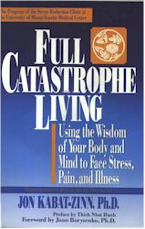
“Perhaps the most fundamental development in behavioral medicine is the recognition that we can no longer think about health as being solely a characteristic of the body or the mind because body and mind are interconnected.”

Slide 9
The Action-Reflection Divide
The unexamined life…
The over-examined life…
The need for reflAction
“Studies of short-term mood indicate that positive affect is more related to action than to thought, such that it is easier to induce a state of high positive affect through doing than through thinking... Two broad classes of activity are particularly conducive to elevated positive mood: (a) socializing and interpersonal behavior and (b) exercise and physical activity.”
David Watson

Slide 10
Exercise and Modernity
Reduction of physical work
Rising levels of depression
The need for exercise
“Our forefathers lived every jot as well as we, when they provided and dressed their own meat with their own hands; lodged upon the ground, and were not as yet come to the vanity of gold and gems.”
Seneca

Slide 11
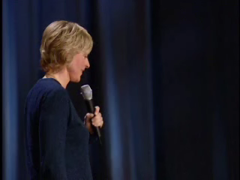

Slide 12
Overcoming Depression (Babyak et al. 2000)
156 patients with Major Depressive Disorder
Three groups (exercise, medicine, exercise*medicine)
Anti-depressant: Sertraline (Zoloft)
Exercise: Thirty minutes three times/week

Slide 13
Overcoming Depression (Babyak et al. 2000)
Results (16 weeks):
  All three groups improved (>60%)
  No significant differences among groups
10 months follow-up
  Relapse medication: 38%
  Relapse medication*exercise: 31%
  Relapse exercise: 9%
For dysthymia (McCann & Holmes, 1984)
Not exercising is like taking depressants

Slide 14
More Benefits
Psychological
  Enhanced self-esteem
  Lower anxiety and stress
  Adjunctive treatment for clinical disorder
  Improved cognitive functioning
Physical
  Weight loss/control
  Stronger immune system
Better Sex
Not a panacea!

Slide 15
Exercise Tips
Some flexibility and strength training
Gradual buildup
Around 5 days a week
30 minutes of moderate aerobic workout
Listen to your body
Quantity affects quality
“Repeated workouts that are too intense to allow complete recovery may cause endurance athletes to experience ‘staleness,’ a syndrome that is characterized by increased psychological symptoms of anxiety with increased sympathetic nervous system, catecholamine, and cortisol base rates.”
Dienstbier & Zillig (2002)

Slide 16
Overcoming barriers
Pain/discomfort
  Divide and conquer
  Distracters (TV, music, etc)
  Social support

Slide 17
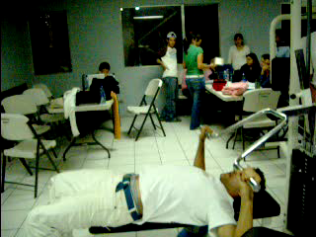

Slide 18
Overcoming barriers
Pain/discomfort
  Divide and conquer
  Distracters (TV, music, etc)
  Social support
Time commitment
  An investment
  Schedule in advance
Subconscious
  Just do it (the five minute take off)
  Body as important as mind

Slide 19
Exercise: The Unsung Hero
“There is evidence that exercise is beneficial for mental health; it reduces anxiety, depression, and negative mood, and improves self-esteem and cognitive functioning. Exercise is also associated with improvements in the quality of life of those living with Schizophrenia. However, exercise is seldom recognized by mainstream mental health services as an effective intervention in the care and treatment of mental health problems.”
Patrick Callaghan

Slide 20
Exercise: The Unsung Hero
“In a way, exercise can be thought of as a psychiatrist’s dream treatment. It works on anxiety, on panic disorder, and on stress in general, which has a lot to do with depression. And it generates the release of neurotransmitters—norepinephrine, serotonin, and dopamine—that are very similar to our most important psychiatric medicines. Having a bout of exercise is like taking a little bit of Prozac and a little bit of Ritalin, right where it is supposed to go.”
John Ratey

Slide 21
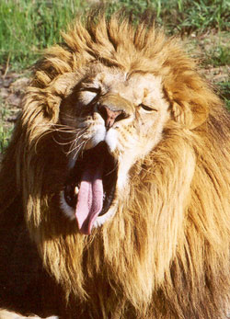
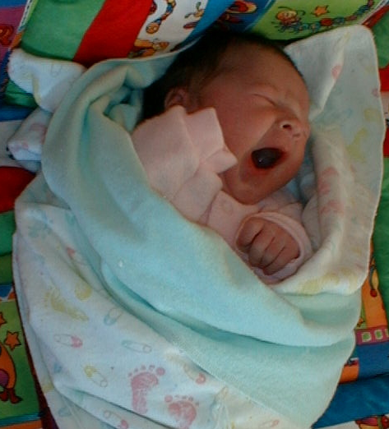
Sleep
Pre-Edison: 10 hours/day
Today: 7 hours/day
25% of 18-29 year olds get 8 hours
Make sleep a priority

Slide 22
Effects of Sleep
Immune system
Energy levels
Weight
Motor skills (accidents)
Stress/anxiety levels
Depression
Cognitive functioning

Slide 23
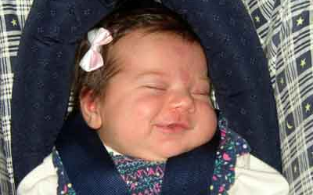
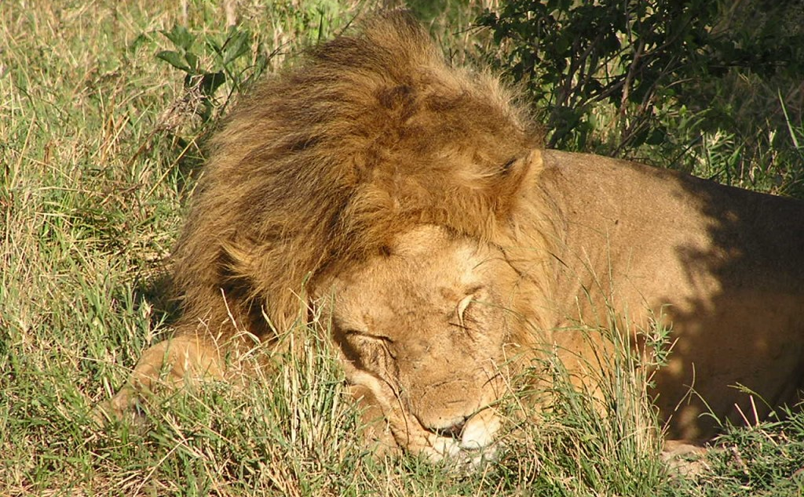
Sleep Tips
8 hours/day
Nap time
Watch your exercise and food
Permission to be human
Pay attention to internal rhythms

Slide 24
Good Night, Good Life
“Effects of sleep deprivation on health and well-being have been documented by research. Cognitive skills and physical performance are impaired by sleep deprivation, but mood is affected even more. People who get less than a full night's sleep are prone to feel less happy, more stressed, more physically frail and more mentally and physically exhausted as a result. Sufficient sleep makes us feel better, happier, more vigorous and vital.”
William Dement

Slide 25
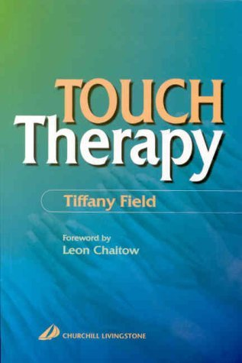
Getting In Touch With Touch
Physical health
Mental health
Better sex life (Masters & Johnson)

Slide 26
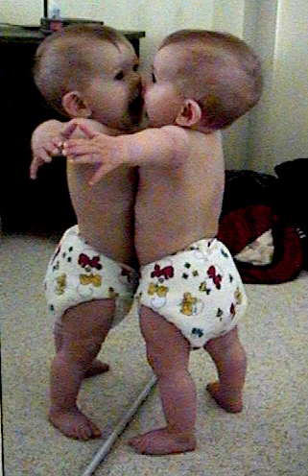
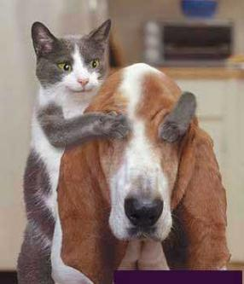
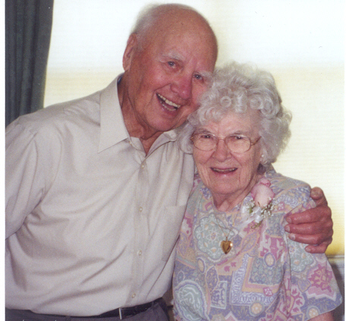
The Need for Touch
“We need 4 hugs a day for survival.
We need 8 hugs a day for maintenance.
We need 12 hugs a day for growth.”
Virginia Satir
Win-win
Respecting self and others

Slide 27


Slide 28
Bibliography and Recommendations
Babyak, M., et al. (2000). Exercise Treatment for Major Depression: Maintenance of Therapeutic Benefit at 10 Months. Psychosomatic Medicine, 62, 633-638.
Benson, H. (1997). Timeless Healing. Scribner.
Field, T. (2003). Touch. Bradford Books.
Murphy, S. (2004). Run for Life: The Real Woman’s Guide to Running. The Lyons Press.
Salmon, P. (2001). Effects of Physical Exercise on Anxiety, Depression, and Sensitivity to Stress: A Unifying Theory. Clinical Psychology Review, 21, 33-61.
Sarno, J. E. (1991). Healing Back Pain: The Mind-Body Connection. Warner Books.
Trockel, M. T. et al. (2003). Health-Related Variables and Academic Performance Among First-Year College Students: Implications for Sleep and Other Behaviors. Journal of American College Health, 49, 3.

